Slide 1
Robustness of Sequence Models
Peter Fazekas
Sanjif Shan
Warwick University

Slide 2
Introduction: Neural Networks
Skipping the jargon, a neural network (NN) is a map
f : input ➝ output
There are NOT MANY restrictions on the inputs and outputs.
INPUT | OUTPUT
Pictures of Animals | Animal (and number of each species)
Pictures of Clothes | Estimated resale value
Pictures of Food | Food Type (and possible allergens?)
Table: Possible Input-Output pairs for a Neural Network

Slide 3
How do Neural Networks Learn?
NNs work by learning from experience
To build an animal classifier :
We train a NN with animal pictures and their associated animal names
To train a NN, we need to
Define a measure of how accurate the NN is.
With this measure, allow the NN to learn from its mistakes, becoming better with experience

Slide 4

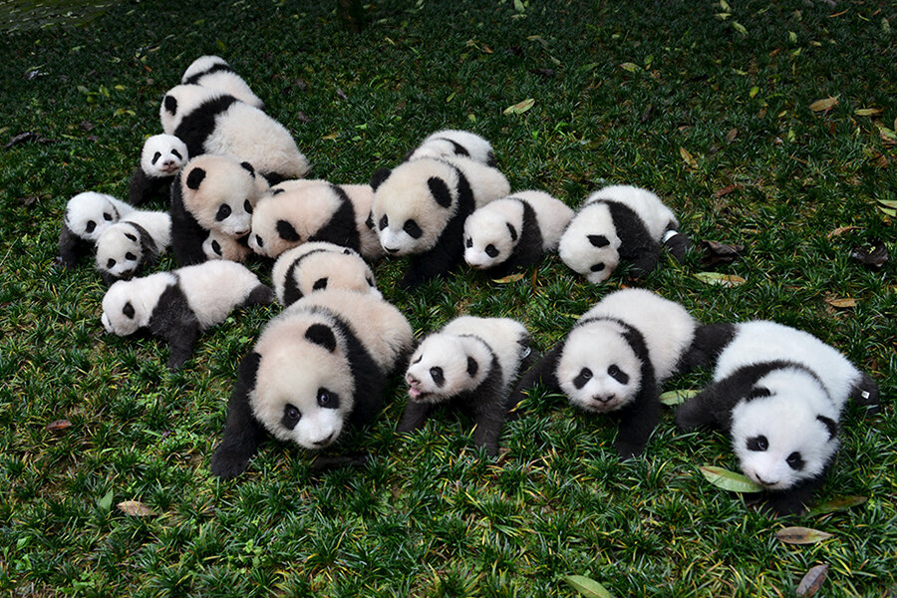
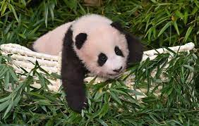
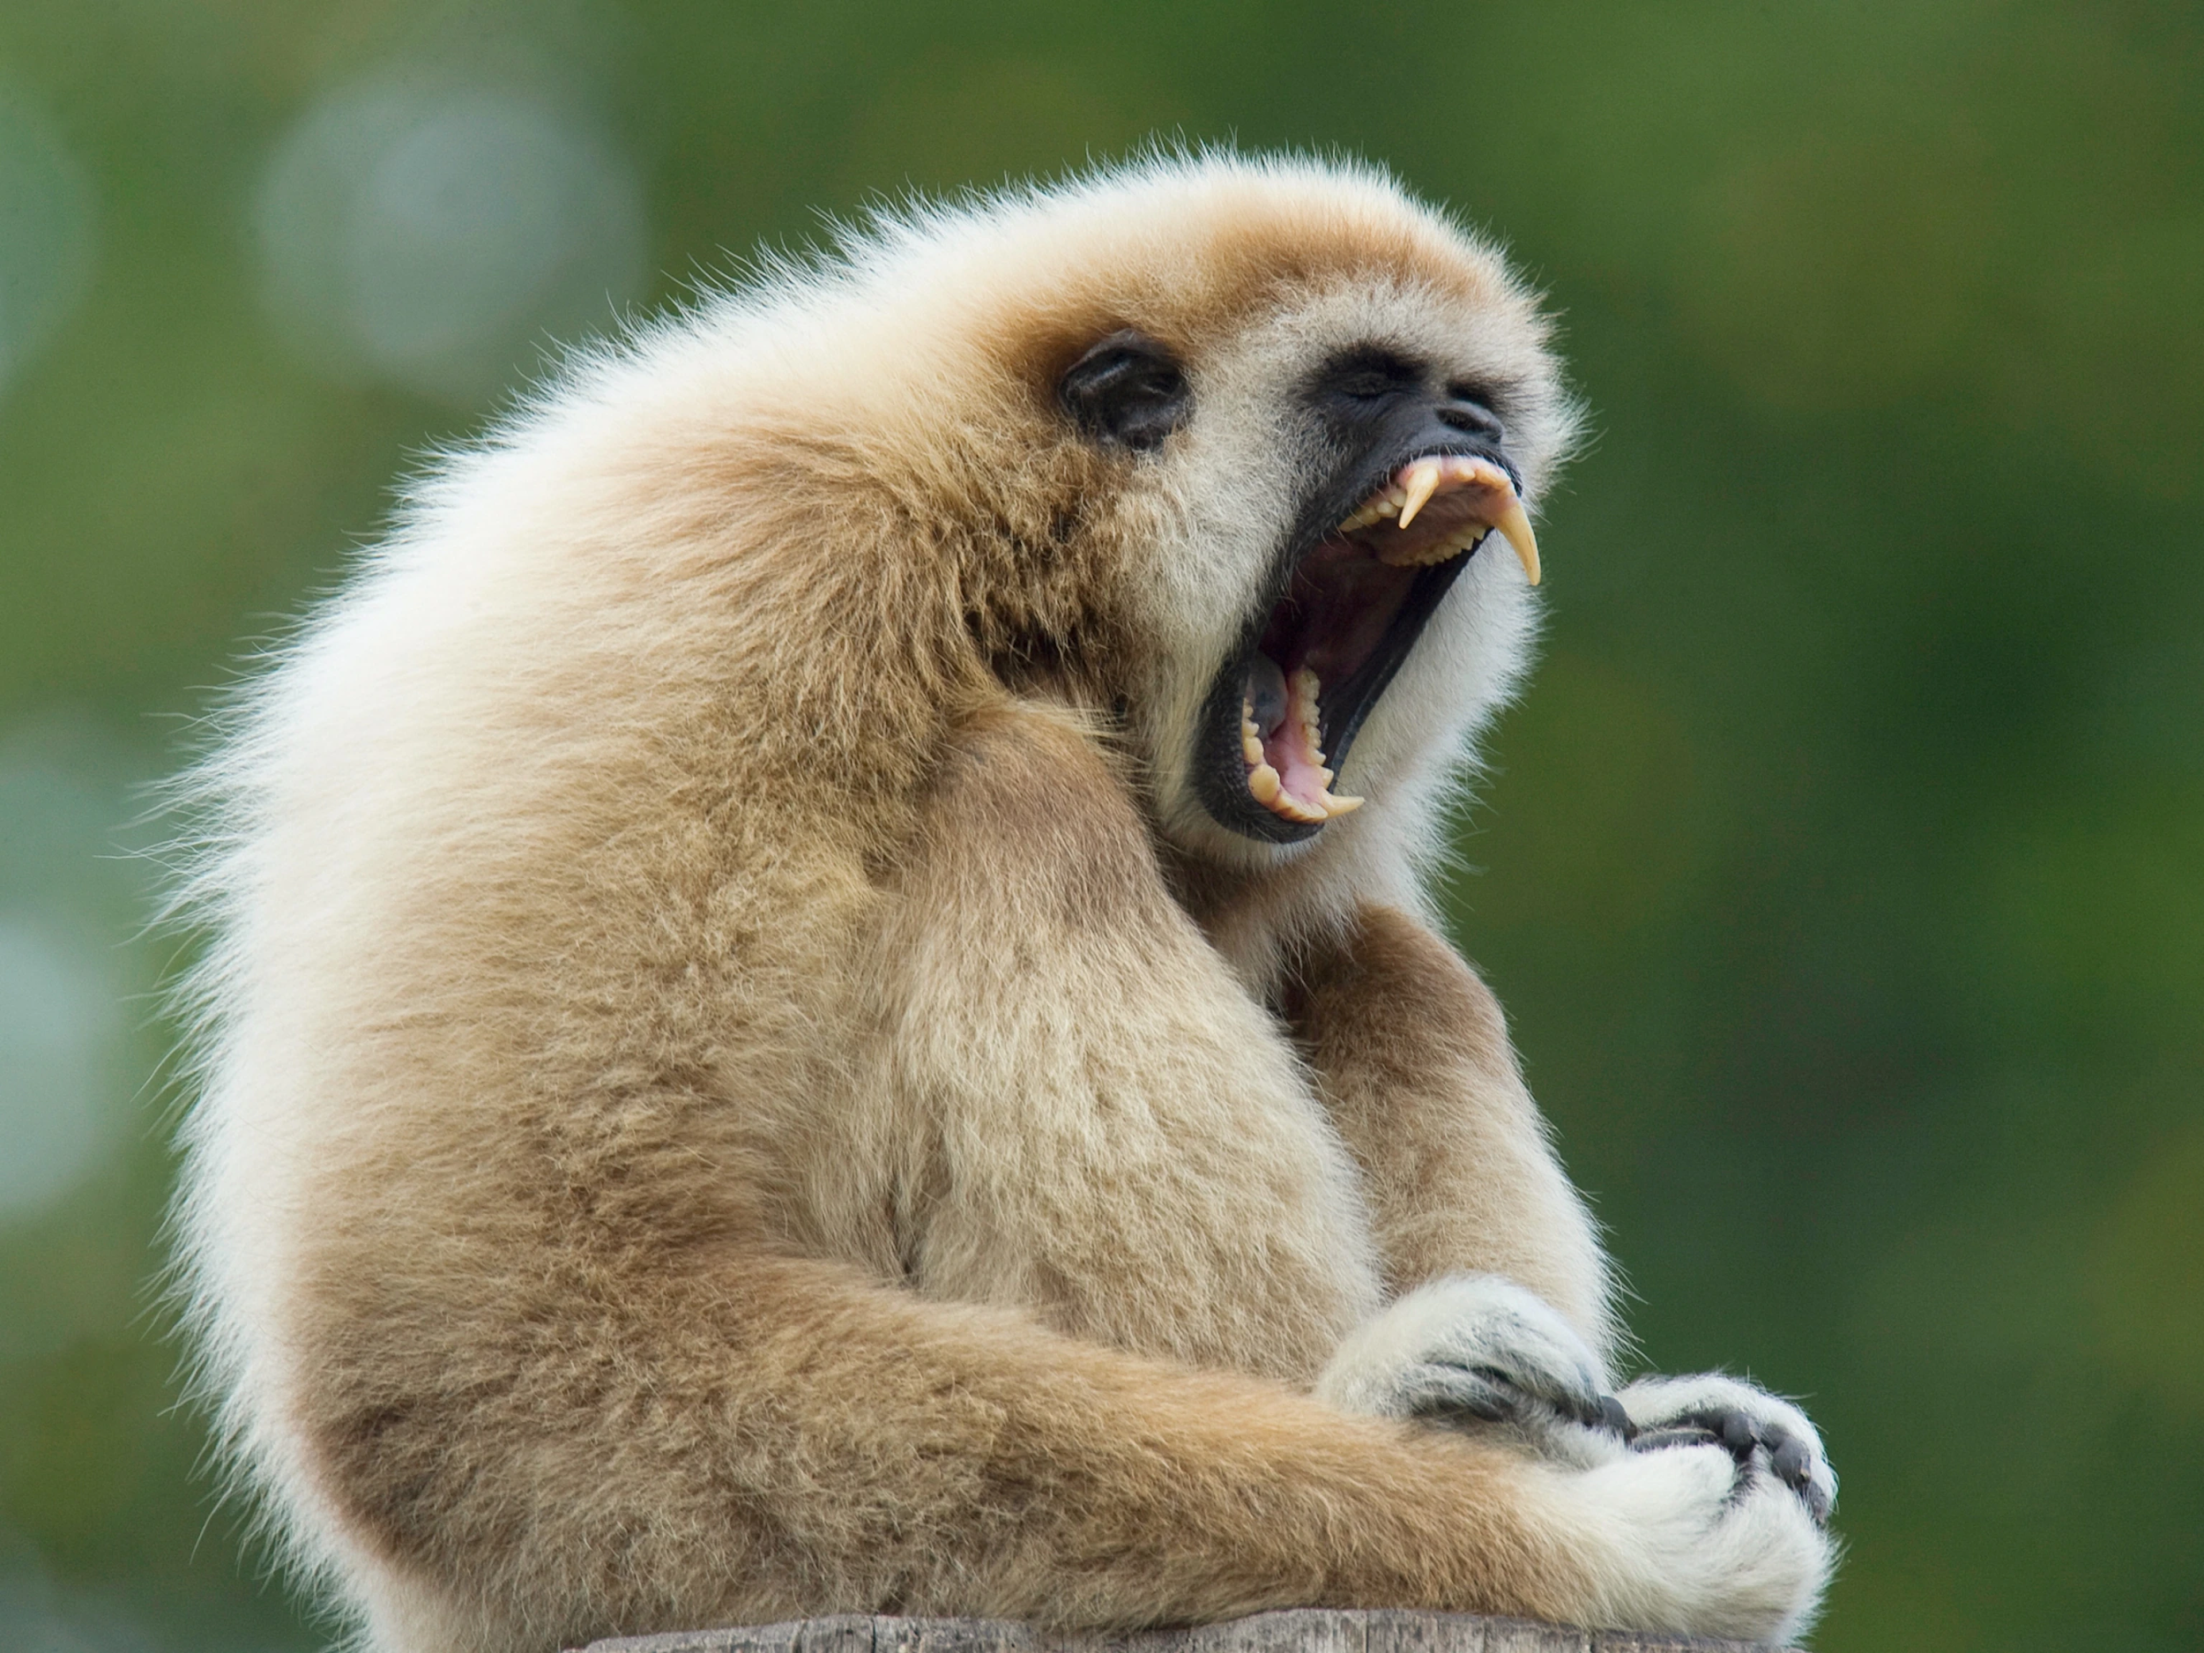
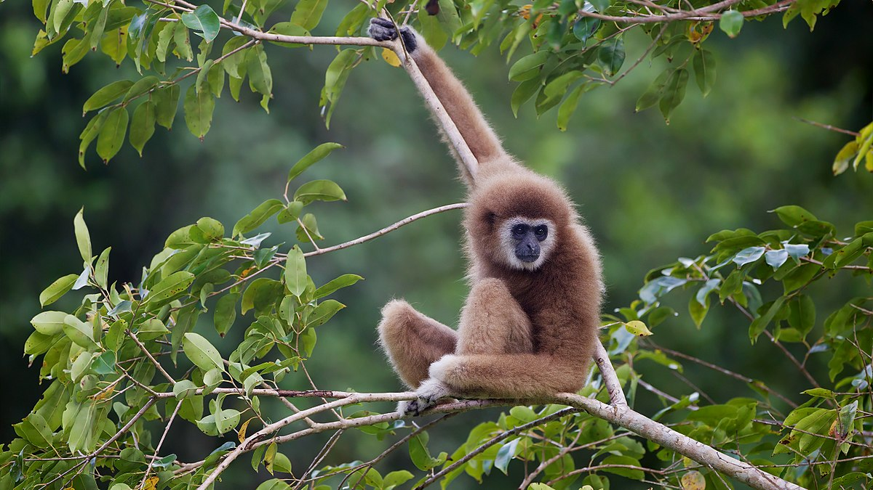
(arbitrary) data coordinate
How do Neural Networks Learn?
This Curve defines the difference between pandas and gibbons
Graph: Panda vs Gibbon

Slide 5
How do Neural Networks Learn?
(arbitrary) data coordinate
This Curve is learned by the NN
This Curve defines the difference between pandas and gibbons
Graph: Panda vs Gibbon (reunited at last)

Slide 6
What COULD POSSIBLY go wrong?
Misclassification
When a NN does not learn accurately.
Adversarial Attacks
This is when corruptions fool a classifier.

Slide 7
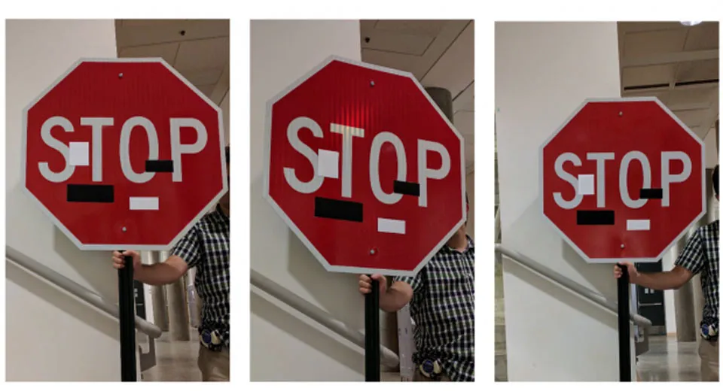
What do you SEE? A stop sign or a speed limit?
Figure: State of the art NNs have been shown to classify this as a 30mph sign

Slide 8
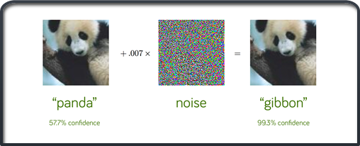
Adversarial attack
Figure: Corruptions Imperceptible to the eye may result in a panda being named a gibbon

Slide 9
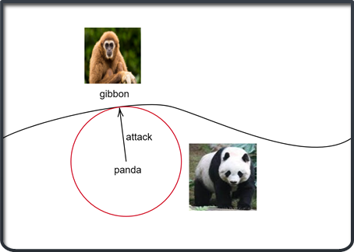
Attack on Panda
=
The two images convey the same idea.
performing an attack on an image = perturbing it in dataspace
Is curvature relevant?

Slide 10
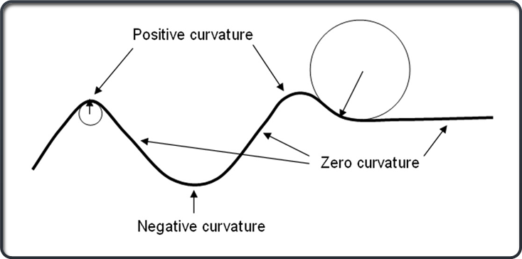
Why differential geometry?
Figure: Differential geometry 101
•Easier to develop a notion of curvature
• More fundamental description
• More versatile
•Links previous research together and provides a new insight

Slide 11
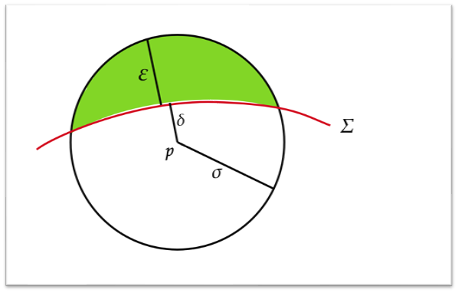
Random Attacks
•Not targeted
•Does not always cause misclassification
•How can we describe the probability of misclassification?
Figure: Tubular regions for misclassification

Slide 12
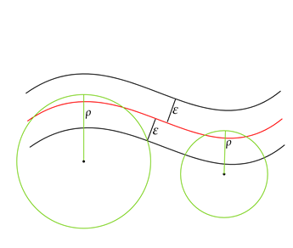
Tubular regions/random training
•Explicit upper bound on proportion of sphere intersecting the tube, depends on curvature
•Smaller curvature = less intersection volume
•Is moving a point randomly beneficial under this condition?
•Yes! It improves on an existing defense method
Figure: Tubular regions

Slide 13
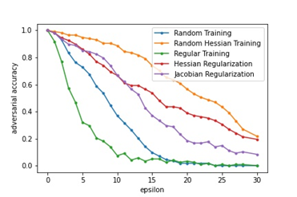
Random Hessian Training
Perturb training data and label it with the same class
Does not perform well on its own (blue graph)
With Hessian regularization it outperforms the other four models (orange graph)
Consistent with theoretical analysis of tubular covers

Slide 14
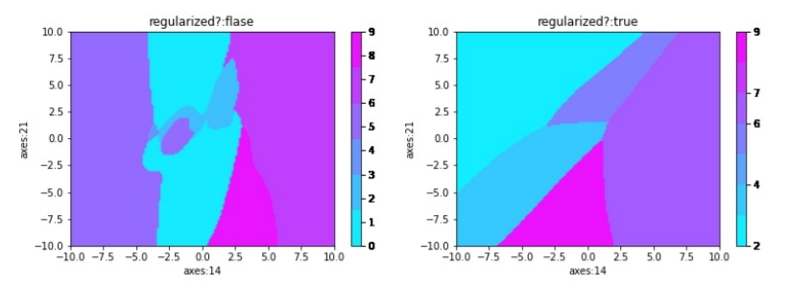
Random Hessian Training Results
Figure: Hessian Training smoothes the curves and increases robustness to attacks

Slide 15
Bound on Misclassification Probability
Given a datapoint and perturbation radius, we want to find the probability of misclassification on the ball
This probability can be approximated by the following process:
Generate n random points in the ball
Count the number of misclassified points, n_misclassfied
Probability of misclassification ⋍ n_misclassified/n

Slide 16
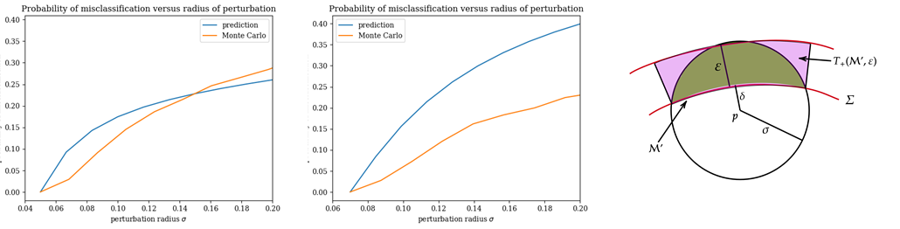
Probability of misclassification experimental results
•Tubular idea again?
•Explicit upper bound on probability of random perturbation fooling a classifier
•Proportion of sphere intersecting tube = probability of misclassification
•Difficult to calculate, experiment is only approximate

Slide 17
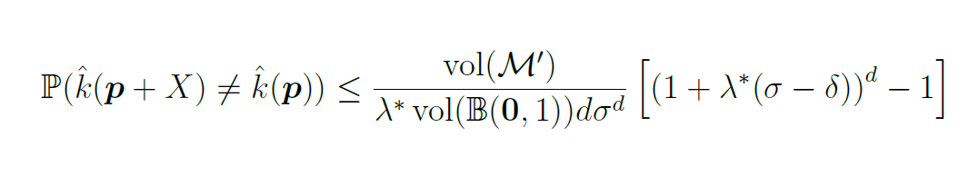
Explicit upper bound
The formula directly depends on curvature
Higher positive curvatures lead to a higher probability of misclassification
Similarly, lower curvatures lead to a smaller probability

Slide 18
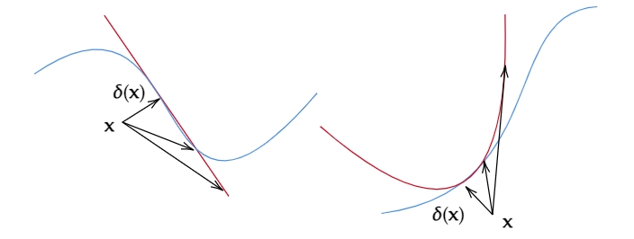
Bound on Misclassification Probability
Figure: Approximation to the decision boundary to first order (left) and second order (right)

Slide 19
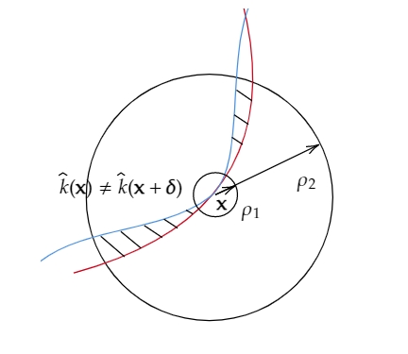
Theoretical bound based on second order approximation
Figure: Second order approximation only works well for small perturbation radii

Slide 20
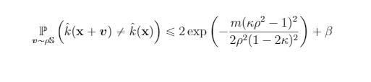
Theoretical Bound
For small perturbation radius
Don’t expect to understand this! All this formula shows is that probability of misclassification decreases with curvature.

Slide 21
Conclusions
Robustness increases with smaller curvature.
We have proved this theoretically and experimentally.
We hope this inspires further research into curvature regularisation techniques to improve robustness.

Slide 22
Thank you!
We’re happy to answer any questions...
https://github.com/SanjifShan
https://github.com/peterfazekas1999

